Slide 1
NucE497: Reactor Fuel Performance
Exam review
Muhammet Ayanoglu
Department of Mechanical and Nuclear Engineering
February 29,2017

Slide 2
Exam Date:
Mar 2 at 12 am – Mar 3 at 11:59 pm
Total time:
2 hours (Download+Solve+Convert/Upload)
If you create your PDF and then fine something you would like to change, you are permitted to edit your PDF or add notes before submitting. I recommend you have two methods set up to convert your solutions to a PDF, as I will not accept "I couldn't make the PDF" as a valid excuse.

Slide 3
Exam Format
Exam includes both conceptual and workout problems.
Conceptual questions include everything discussed in the class.
Workout problems will be similar to the problems you did on the homework, or that we did in class.
Make sure and study thoroughly for the exam

Slide 4
Course content
Module-1: Fuel basics
Module-2: Heat transport
Module-3: Mechanical Behavior
Module-4: Materials issues in the fuel
Module-5: Materials issues in the cladding
Module-6: Accidents, used fuel, and fuel cycle

Slide 5
You are responsible for the first three modules…
Module-1: Fuel basics
Module-2: Heat transport
Module-3: Mechanical Behavior
Module-4: Materials issues in the fuel
Module-5: Materials issues in the cladding
Module-6: Accidents, used fuel, and fuel cycle

Slide 6
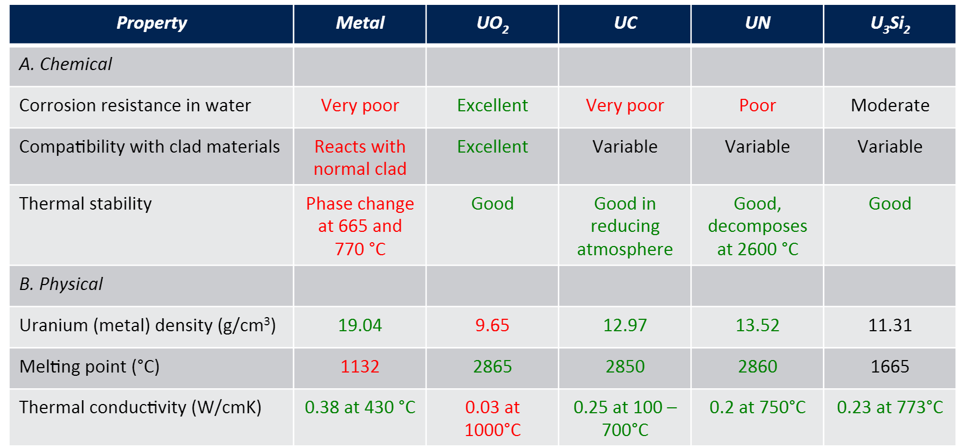

Module-1: Fuel basics
$$Q[\frac{W}{{cm}^{3}}]=E_{f}N_{f}σ_{f}φ_{th}$$
Volumetric heat generation:

Slide 7
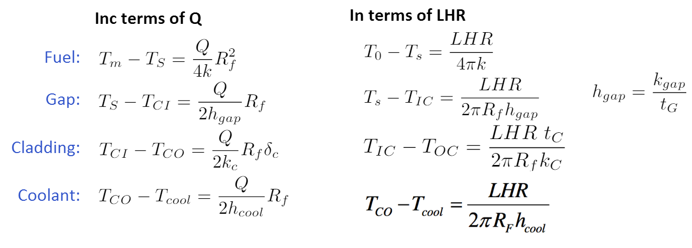
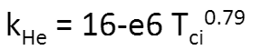
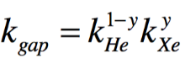
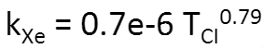
Module-2: Heat transport
Gap thermal conductivity:

Slide 8
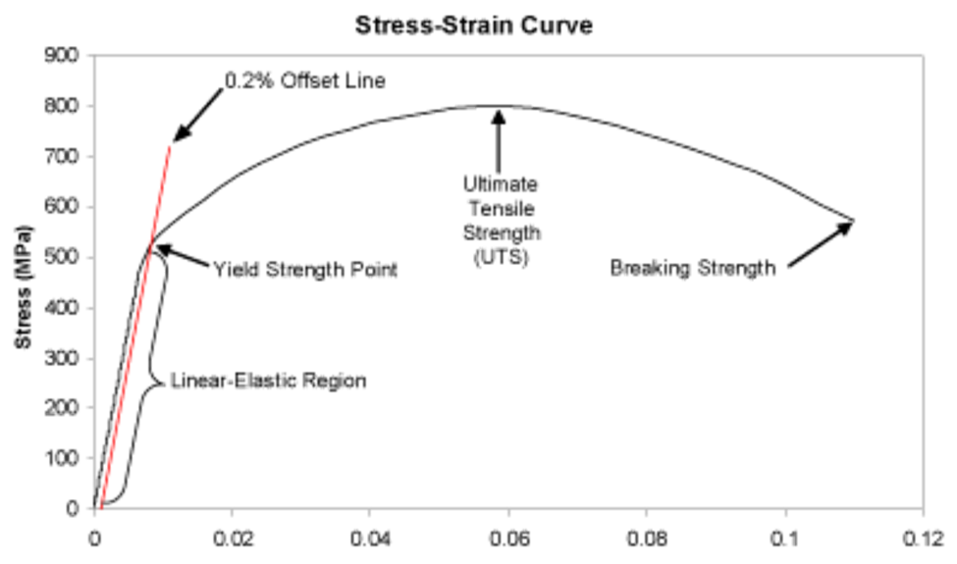
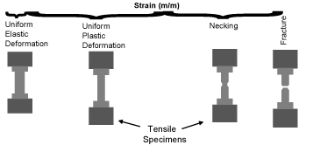
Module-3: Mechanical behavior

Slide 9
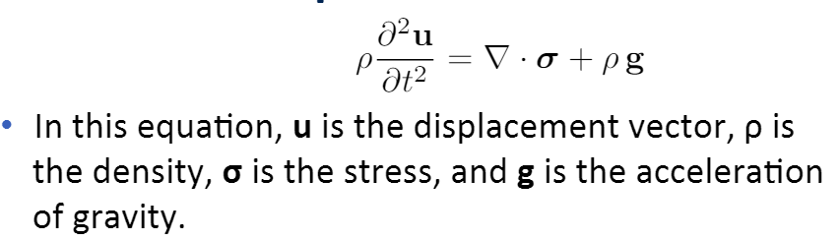
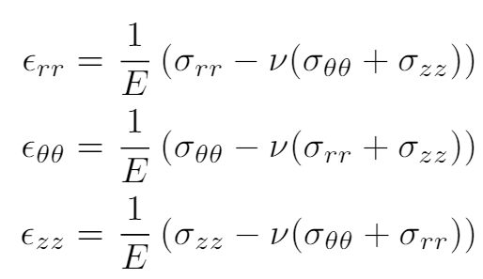
Module-3: Mechanical behavior
Assumption-1: Static body,
Assumption-2: Gravity is negligible
Assumption-3: Problem is axisymmetric
Assumption-4: Isotropic material response

Slide 10
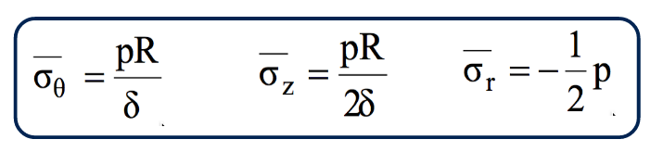
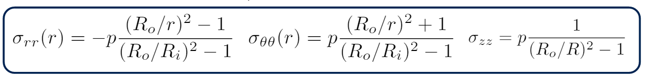
Module-3: Mechanical behavior
Thin wall assumption:
Thick wall assumption:
Notes:
Which stress is the largest? At what position r will the hoop stress be the largest?

Slide 11
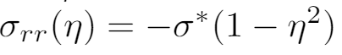
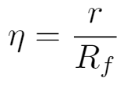
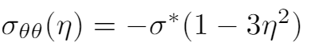
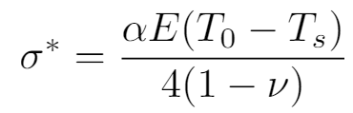
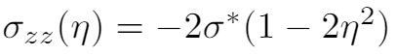
Module-3: Mechanical behavior
If we include thermal stresses result from thermal gradient
Notes:
Which stress is the largest? At what position r will the hoop stress be the largest?

